Slide 1

Phishing Awareness
Spot the hook before you click.

Slide 2
Cybersecurity Essentials
"Attackers do not break into systems first. They manipulate people."
CYBERSECURITY ESSENTIALS

Slide 3






Psychology of Phishing
Urgency
Familiarity
Curiosity
Act now or lose access. High-pressure tactics intentionally make you skip standard security checks and act on impulse.
It looks exactly like your bank, your boss, or a brand you already trust implicitly, lowering your natural defenses.
A surprise invoice, a shocking photo, or an unexpected package update you just feel compelled to open.

Slide 4
The Scale of the Problem
A Continuous Threat
3.4B
Phishing is not a rare occurrence; it is a massive, automated industry. The volume of attacks ensures that even a tiny success rate yields profits.
Furthermore, it takes an average of 295 days to identify and contain a data breach caused by phishing, highlighting the severe long-term impact on organizations.
Emails Sent Daily

Slide 5






Mismatched Sender
Urgent Threats
Four Red Flags to Watch
The display name might look familiar, but the actual email address belongs to an unknown domain.
"Your account will be closed in 24 hours." They use fear to force you into immediate action.
Be on the lookout for these common indicators of a phishing attempt in your inbox.
Suspicious Links
Credential Requests
When you hover over the link or button, it points somewhere completely unrecognized.
No legitimate company or IT department will ever ask for your password directly via email.

Slide 6
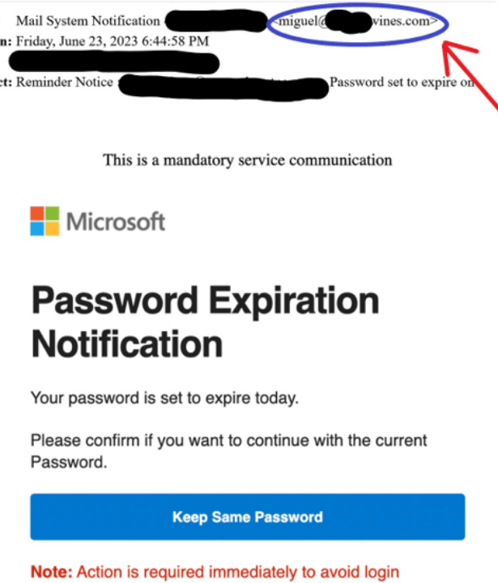
Anatomy of an Attack
Spotting the Fakes
Phishing emails are carefully engineered to deceive. They often spoof legitimate domains to appear authentic at a quick glance.
Attackers create a false sense of urgency and hide malicious links behind generic action buttons like "Reset Password" or "View Secure Invoice".

Slide 7

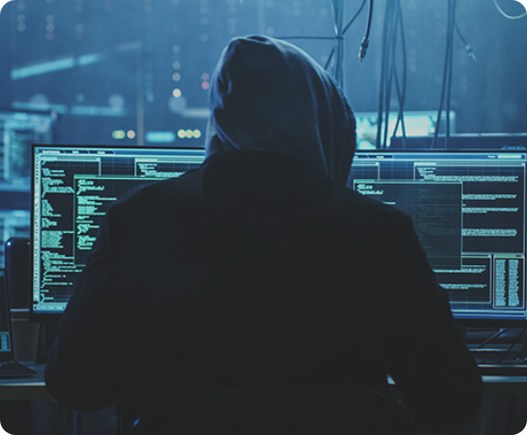
Spear Phishing
Highly Targeted Attacks
Unlike mass spam emails, these attackers meticulously research you beforehand.
They know your name, your specific role, and sometimes your recent projects.
Always verify unexpected requests, even if they appear to be from executives or vendors.

Slide 8



The Three Second Check
1. Stop
2. Inspect
3. Verify
Do not click on reflex. Slow down for a moment and consciously suppress the urge to act immediately on the email.
Check the actual sender address and carefully hover over any links to reveal their true URL destination.
Unsure? Confirm the request through a secondary channel you already know and trust, like a phone call.

Slide 9



When In Doubt
Do
Avoid
Pause and read the full sender address carefully.
Clicking or opening attachments in a rush.
Replying to the email with passwords or codes.
Hover over links before clicking anything.
Report it to IT immediately, then delete it.
Trusting a logo or a familiar name alone.

Slide 10


Incident Response
What if you click?
Don't panic. Mistakes happen, but how you react makes all the difference.
Disconnect your device from the network immediately to prevent malware from spreading.
Contact the IT Helpdesk right away. Prompt reporting is critical to minimizing the damage.

Slide 11

Key Takeaways
Most attacks start with a single convincing email.
Watch for urgency, odd senders, and link or password requests.
When in doubt, stop and verify through a trusted channel.
Spot something suspicious? Report it to IT right away.

Slide 12

Stay Vigilant
Thank you for protecting our network.
security@yourcompany.com • IT Helpdesk: Ext 5555

Slide 13



Image Sources
https://winonait.com/wp-content/uploads/2023/10/close-up-of-the-scam-email-.png
Source: winonait.com
https://www.avast.com/hubfs/New_Avast_Academy/Hackers/Hacker-Thumb-a1.png
Source: www.avast.com
https://d3njjcbhbojbot.cloudfront.net/api/utilities/v1/imageproxy/https://images.ctfassets.net/wp1lcwdav1p1/2TnKwEX8d7RNnAbwbQECAR/fbea6f491a42381ef441e8ff7733154b/GettyImages-1436060194.jpg?w=1500&h=680&q=60&fit=fill&f=faces&fm=jpg&fl=progressive&auto=format%2Ccompress&dpr=1&w=1000
Source: www.coursera.org

